Slide 1

Hell freezing over
PowerShell on Linux and GitHub
Bartosz Bielawski, Optiver

Slide 2


Slide 3


Slide 4
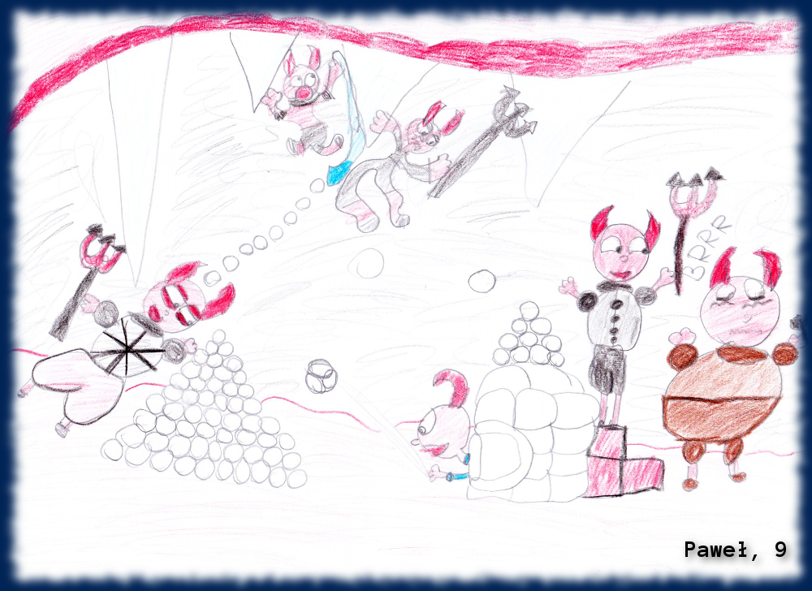
Agenda
About past, dream, presence and future
PowerShell on Linux
Installation
Basics
Practice
PowerShell on GitHub
Fixing PowerShell
How can I help?

Slide 5



Past – Dream – Future
Installer
Optional feature
Part of OS
Everything – windows
Xplat
Open Source

Slide 6
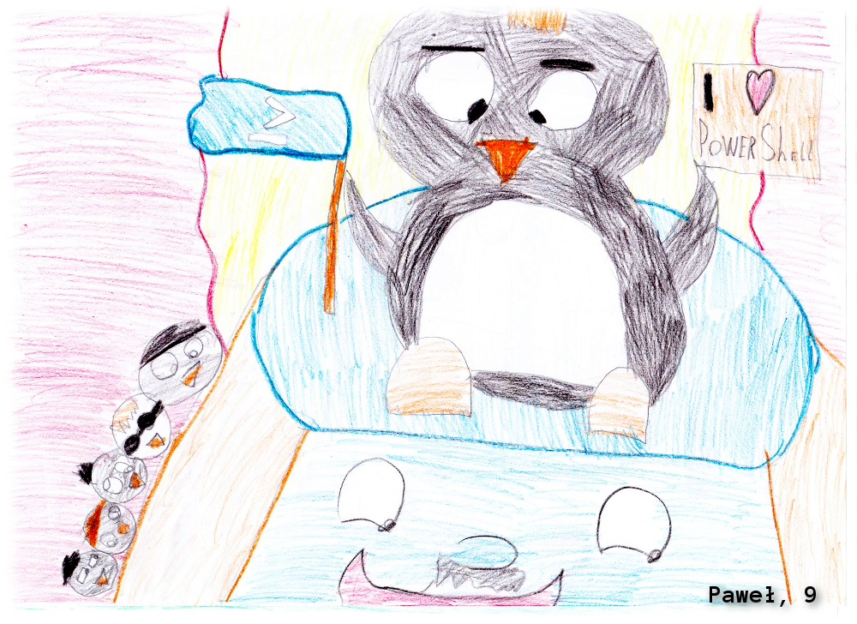
Demo

Slide 7

Demo

Slide 8

Summary
From caterpillar to butterfly
PowerShell is everywhere!
PowerShell is ours!

Slide 9
Next Steps...
Now: 15 min break
Grab a coffee
Stay here to enjoy next presentation
Change track and switch to another room
Ask me questions or meet me in a breakout session room afterwards

Slide 10
about_Bartek.help.txt
Windows Engineer @ Optiver
MVP: PowerShell Cloud Something Something
Book author: „PowerShell 5.0 Biblia“ (PL)
PowerShellMagazine.com/PowerShellPL.NET
Optiver is hiring!
DevOps Engineer
…?

